Slide 1
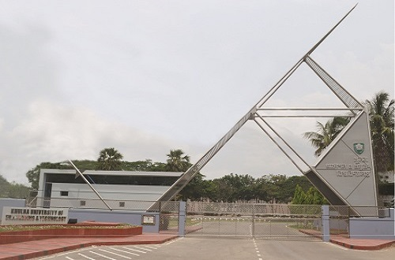
Presentation on KUET (Khulna University Of Engineering & Technology)
CSE-4120: Technical Writing and Seminar
Presented By
Md. Shoriful Islam
Roll : 1807082

Slide 2
Outline
Other Facilities
Introduction
Offered Programs
Faculties and Departments
Residential Facility

Slide 3
Introduction
Located in Teligati, Fulbarigate, Khulna
Khulna Engineering College in 1967
Bangladesh Institute of Technology, Khulna in 1986
Khulna University Of Engineering and Technology(KUET) in 2003
Total Area of 117.35 acres

Slide 4
Offered Programs
Under Graduate
Post Graduate
Post Graduate Diploma
Professional Diploma

Slide 5
Faculties and Departments
Faculties - 3
Departments - 20

Slide 6

Faculty of Electrical and Electronic Engineering
Department of Electrical and Electronic Engineering
Department of Computer Science and Engineering
Department of Electronics and Communication Engineering
Department of Biomedical Engineering
Department of Materials Science and Engineering

Slide 7
Faculty Of Mechanical Engineering
Department of Mechanical Engineering
Department of Industrial Engineering and Management
Department of Energy Science and Engineering
Department of Leather Engineering
Department of Textile Engineering
Department of Chemical Engineering
Department of Mechatronics Engineering

Slide 8
Faculty Of Civil Engineering
Department of Civil Engineering
Department of Urban and Regional Planning
Department of Building Engineering and Construction Management
Department of Architecture
Department of Mathematics
Department of Physics
Department of Chemistry
Department of Humanities

Slide 9
Residential Facilities
Khan Jahan Ali Hall
Dr. M.A Rashid Hall
Bangabandhu Shiekh Mujibur Rahman Hall
Amar Ekushey Hall
Fazlul Haque Hall
Lalon Shah Hall
Rokeya Hall

Slide 10
Other Facilities
Playground
More than 10 clubs ( Educational and Cultural )
Central Library
Medical Center
Transportation
Central Computer Center
Student Welfare Center
Sheikh Kamal It Incubation & Training Center

Slide 11
Thank you

